Slide 1
HTML5 and CSS3
Working with Floats

Slide 2
Assessing the CSS Box Model
Box model: used by CSS to represent characteristics of every Web page element
Treats element as rectangular box
Border: border surrounding element
Margin: space from border to neighboring/parent element
Padding: space between border and element content

Slide 3
Assessing the CSS Box Model (continued)
Size of padding, margin, and border increase the amount of space occupied by an element
Dimensions of these properties not included in specified width / height
Specified width and height refer only to the content of an element
When fitting elements into limited space, subtract padding, margin, and border area to get width or height
When bottom margin of one element is adjacent to top margin of another, the margins combine to the size of the larger of the two
Affects element size planning

Slide 4
Assessing the CSS Box Model (continued)
How to define margins and paddings
Separate property for each side of padding and margin
e.g., padding-top:2px; margin-right:1px;
Can set a common value using generic property
e.g., padding:0;
Can use shorthand to set different values
e.g., margin: 1em 2em 1em 3em Values applied clockwise, first value for top
If less than four values provided:
Three values: top, left and right, bottom
Two values: top and bottom, left and right
How to define borders
Shorthand to set all 3 properties in 1 line
border:3px solid #000000 equivalent to border-width:3px;border-style:solid;border-color:#000000;
Or you could have a separate property for each border
border-top-width:3px;

Slide 5
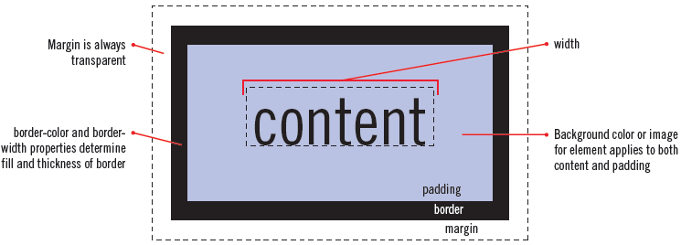
Assessing the CSS Box Model (continued)

Slide 6
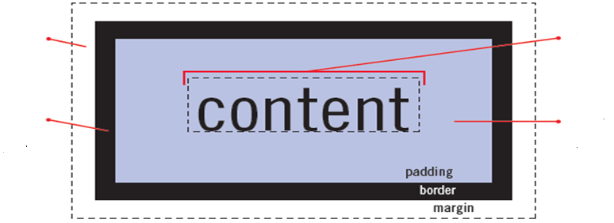
Assessing the CSS Box Model (continued)
margin-left:1px
width:10px
margin-right:1px
border-left:1px
padding-right:1px
border-right:1px
padding-left:1px
Total horizontal space occupied on web page: 1px+1px+1px+10px+1px+1px+1px=16px

Slide 7
Constructing a Multicolumn Layout with Float
User Agents render HTML top to bottom
Easy to create layouts with elements stacked vertically
Use float, clear, and width properties to create columns of text and graphic parallel to each other
Use width property to assign width to each of the columns

Slide 8
Float
When we make an element float, we ask the browser to shift it sideways, either to the left or to the right, as far as it will go.
We can position <div> boxes with the CSS "float:" property.
This will position a box much like an image.
Text can be made to wrap around the boxes (or not).

Slide 9
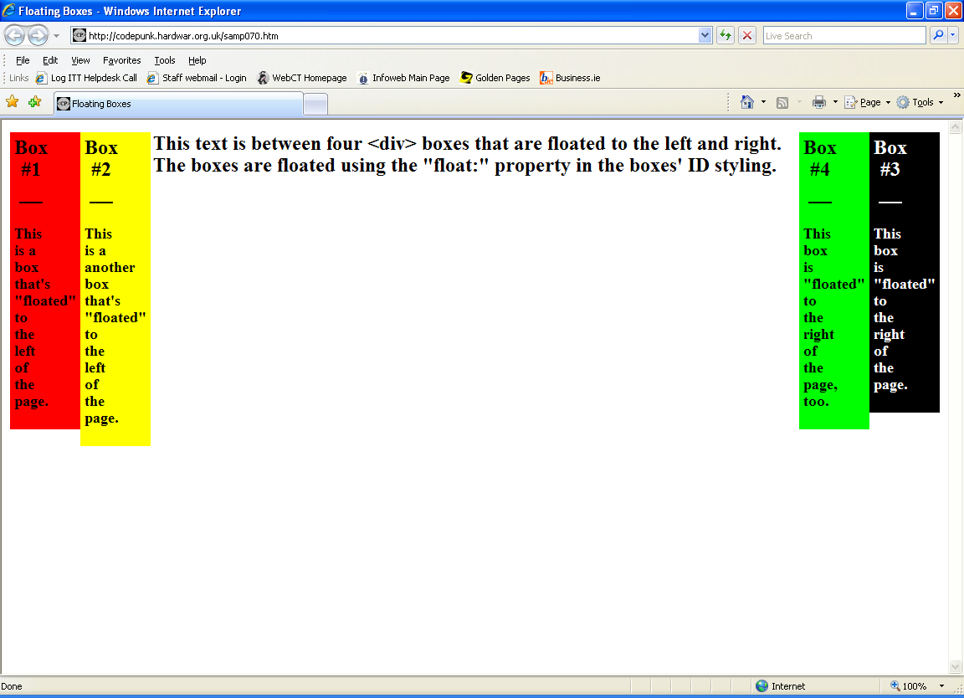

Slide 10
Lets do an example!
Lets begin by making a page with some default text we want our boxes to float around:
<body> <h3>This text is between two...</h3>
</body>
This is just a really simple page of text.

Slide 11
Lets do an example! (continued)
Now lets code "Box #1", the red box.
For starters, all floated boxes must be coded before any text that's to be presented beside or between them.
<body> <div id="box1"> <h2 >Box #1</h2>... </div> <h3>This text is between two...</h3>
</body>
Again, take special notice that the box is placed before the text in your code

Slide 12
Lets do an example! (continued)
Now lets style Box#1 and use "float:" to position it to the left.
<style type="text/css"> #box1{ width: 50px; border: none; background-color: #ff0000; padding: 5px; float: left; }
The only new thing here is the "float:" property. This is what places the box to the left of the screen and puts the text to the right.

Slide 13
Dual Column Float
Now lets make the black Box #3 to the far right. We code this box before the page's text just like with Box #1. We can code it before or after Box #1, but it must come before the page's text.
<body> <div id="box1"> <h2>Box #1</h2>... </div> <div id="box3"> <h2>Box #3</h2>... </div> <h3>This text is between two...</h3>
</body>

Slide 14
Dual Column Float (continued)
Now lets look at "Box #3's" styling:
#box3 { width: 50px; border: none; background-color: #000000; padding: 5px; color: #ffffff; float: right;
}
At this point, you should have a page with the red and black boxes at the edge of the page and the <h3> text between them.

Slide 15
Three Columns
On to the inner two boxes. The yellow box is styled with "float: left". It appears to the immediate right of Box #1 because its <div> is coded after the <div> for Box #1:
<body> <div id="box1"> <h2 >Box #1</h2>... </div> <div id="box3"> <h2 >Box #3</h2>... </div> <div id="box2"> <h2 >Box #2</h2> </div> <h3>This text is between two...</h3>
</body>

Slide 16
Three Columns (continued)
The new box was coded and styled just like the others and is floated left with "float: left". Because one box has already been floated left, our new Box #2 appears as far left as it can, which is just to the right of the first left floated box.
This occurs because the browser interprets a web page from its code from top to bottom. What's coded first is rendered first.
The first box coded to "float: left" will go the furthest left of the screen. The next box floated left will go as far left as it can.
Can you add the last 2 boxes ?

Slide 17
Float Summary
Please note that all four of the floated boxes are coded before the page's central text.
Boxes that are floated left are presented from left-to-right beginning with the first left floated box in the code.
Boxes that are floated right are presented right-to-left beginning with the first box that's styled with "float: right".
All floated boxes must be coded before any other text or content on the page that is to be presented between or beside them.

Slide 18
Float Summary
float has a simple effect, but follows what can be a quite complicated set of rules.
The effect of the float property is to take an element out of the flow and place it to the left or right of other elements in the same parent element.
Possible values
float can be specified by one of three keywords: none, left and right.
A float of none means that an element flows as it would naturally in the flow of its page.
A float of left means that an element is detached from the natural flow of the page, and is treated as a block element to the left of the rest of the contents of its parent element.
A float of right means that an element is detached from the natural flow of the page, and is treated as a block element to the right of the rest of the contents of its parent element.

Slide 19
Using <br clear="all">
We can force an element to drop below all floating elements via the clear property.
If we specify clear:left the element drops below all elements floating on its left side.
With clear:both we can make sure that an element drops below all floating elements that would otherwise affect it.
Try the example on the next page.

Slide 20
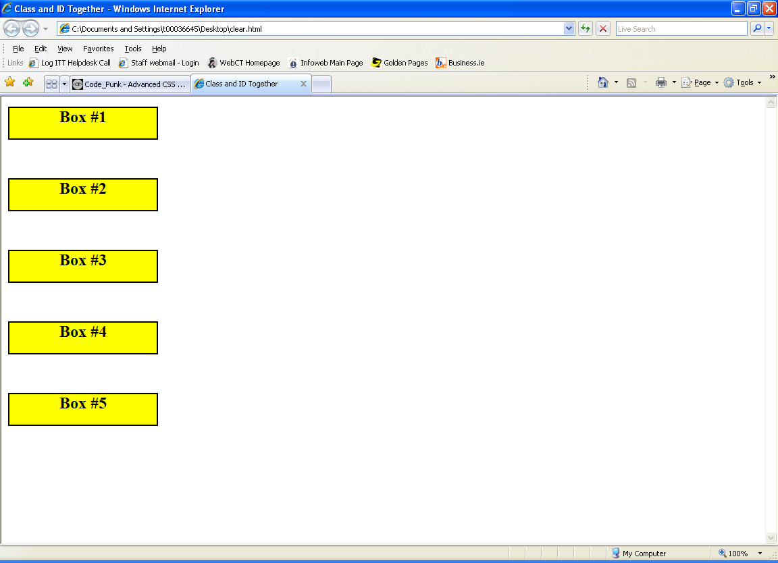

Slide 21
Spacing Between Boxes
You can add some space between the boxes in both browsers by using a "border:" that's colored the same as the background. This border can be as wide as you want to add some space between the boxes.
border: solid white 10px;
The above would put a 10 pixel border around our boxes. The white color would be the same as our example's background. This would give the appearance of 10 pixels of space between our boxes.

Slide 22

Image Gallery using float
.thumbnail {
float:left;
width:110px;
height:90px;
margin:5px;}
</style></head>
<body><h3>Image Gallery</h3>
<img class="thumbnail" src="klematis_small.jpg" width="107" height="90">
<img class="thumbnail" src="klematis2_small.jpg" width="107" height="80">
<img class="thumbnail" src="klematis3_small.jpg" width="116" height="90">
<img class="thumbnail" src="klematis4_small.jpg" width="120" height="90">
<img class="thumbnail" src="klematis4_small.jpg" width="120" height="90">
http://css-tricks.com/all-about-floats/

Slide 23
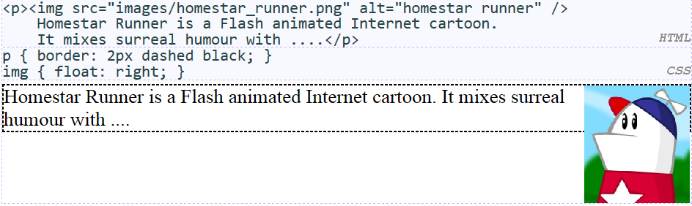
Common error: container too short
If floated elements have non-floated parent elements, the parent will collapse
The problem happens when a floated element is within a container box, that element does not automatically force the container’s height to adjust to the floated element. When an element is floated, its parent no longer contains it because the float is removed from the flow.
We want the p containing the image to extend downward so that its border encloses the entire image.

Slide 24


Common error: container too short
To enforce what we are trying to say:
The parent div in this example will not expand to contain its floated children - it will appear to have height: 0

Slide 25


There are many solutions ……
Set the parent to float itself
Cons: You may not always want the parent floated. Even if you do, do you float the parents' parent, and so on? Must you float every ancestor element?
Give the parent an explicit height
Cons: Not flexible - if the content changes or the browser is resized, the layout will break.

Slide 26



There are many solutions ……
Set parent to overflow: auto/hidden
Cons: Seems like a hack - that's not the overflow property's stated purpose.
Another solution that works in most cases is to have a "clearing div" at the bottom of every container with floats in it. Adding a block element with the style clear:both; onto it will clear the floats past that point and stop the parent of that element from collapsing

Slide 27
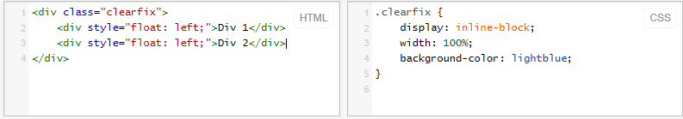
There are many solutions ……
It's also possible to set display: inline-block; and width: 100%; to emulate a normal block element while not collapsing.

Slide 28
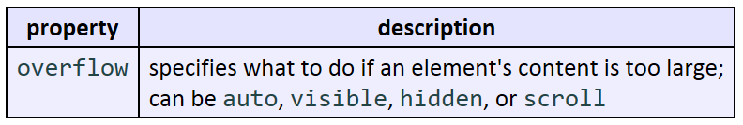
The overflow property

Slide 29
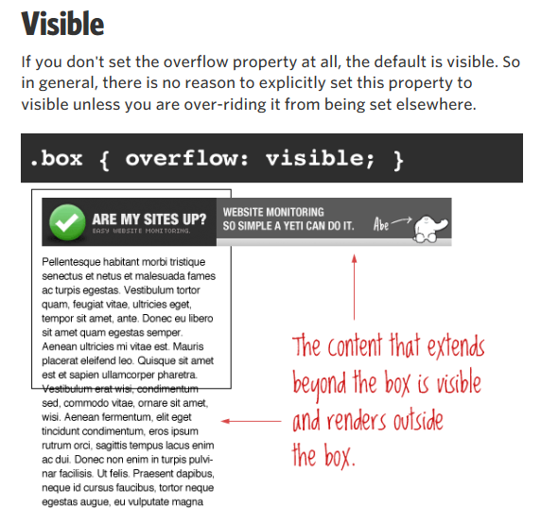
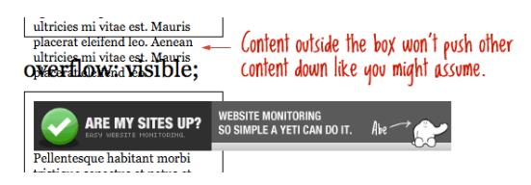
The important thing to remember here is that even though the content is visible outside of the box, that content does not affect the flow of the page. For example:

Slide 30
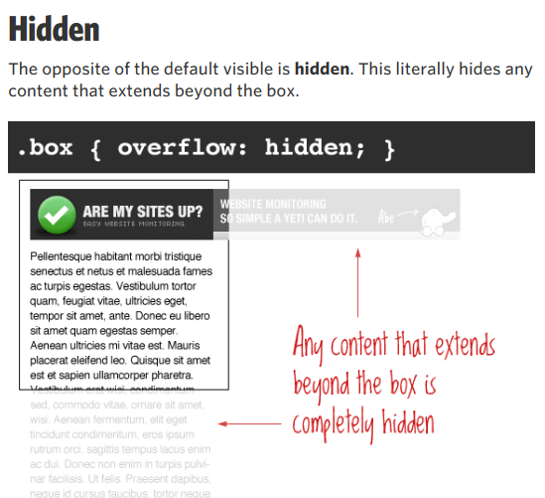
This is particularly useful in use with dynamic content and the possibility of an overflow causing serious layout problems. However, bear in mind that content that is hidden in this way is utterly inaccessible (short of viewing the source).
So for example a user has their default font size set larger than you would expect, you may be pushing text outside of a box and hiding it completely from their view.

Slide 31
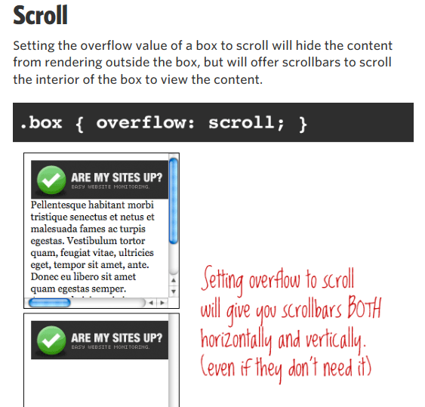
Of note with this value is that you get BOTH horizontal and vertical scrollbars no matter what, even if the content requires only one or the other.

Slide 32
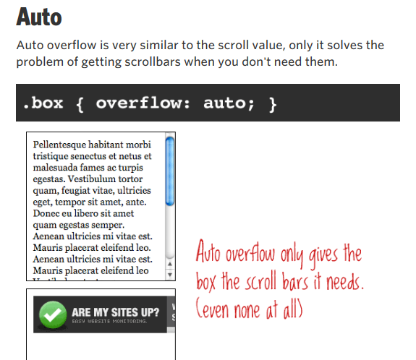
http://css-tricks.com/all-about-floats/

